Slide 1
W205 Project Proposal:
2016 U.S. Political Sentiments
Shuang Chan
David Skarbrevik

Slide 2
Setting up the Research Question
Main Topic: Political sentiments of US during 2016 presidential election
Specific interests:
Average positive approval of democratic/republican candidates
Change in sentiments as a result of key events
News story
Debate
Polls
Twitter API to measure sentiments of US population
Parsing tweets for keywords

Slide 3
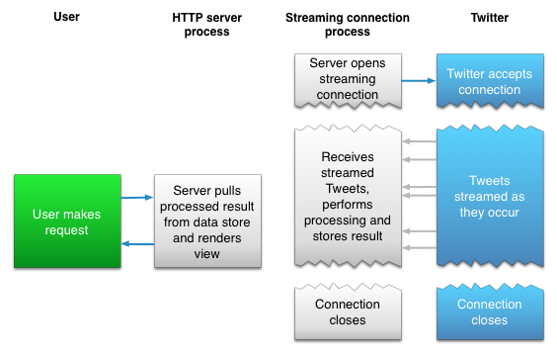
Twitter API
Types of data:
Tweets
Text
URL/Media (if in tweet)
Time/Location
User ID
# of re-tweet
Users
# of followers
# of tweets
How we get the data:
Notes:
REST and Streaming Twitter APIs

Slide 4
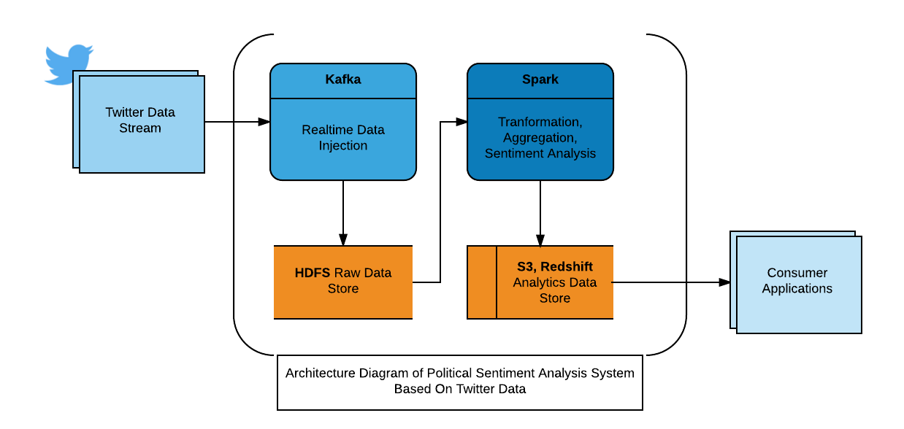
Architectural Diagram
Notes:
Twitter Data Stream is injected into the real-time messaging layer, Kafka.
The data is stored into an HDFS data store.
The data is processed, aggregated and analyzed in Spark.
The analytics data is then stored in S3 or Redshift which is the serving layer for external consumer applications.

Slide 5
Design Considerations
Technical Challenges (volume and velocity)
Twitter API request rate limit
URLS/Media in tweets gives potential for variety of data
Organizational Challenges
Notes:
The volume and velocity of the Twitter data presents a huge technical challenge. A horizontally scalable solution is needed. As noted in the previous diagram, the data injection, storage and processing layers are all based on a distributed environment.
We may face initial budget constraint. We need a solution that requires a small initial investment and very flexible scalability as the demand ramps up and down.

Slide 6
Other Issues
Data Biases
How to tell the story based on the analysis
Notes:
The Twitter data may have many biases. The users on Twitter may have certain political views that are not generalized. Therefore, the algorithm used to determine sentiments needs to be conservative. Any known biases should be noted in the presentation.

